Slide 1
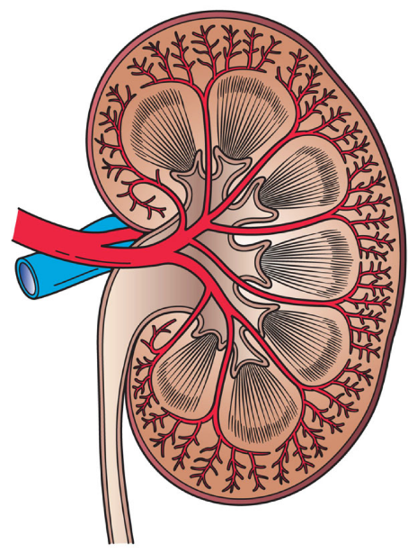
Function of the kidney
Structure and physiology
Blood filtration
Excretion and relation to ureters
Osmosis
Main diseases and Treatments
18.5.1 Explain the function of the kidney
Unit C18.5 Maintaining Haemodialysis Equipment
Module 279 19 C Medical Instrumentation II
©
dr. Chris R. Mol, BME, NORTEC, 2015

Slide 2
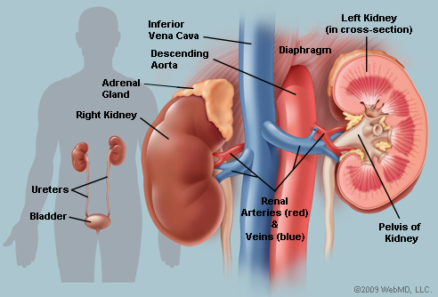
Kidneys: Position and Structure
The kidneys are two bean-shaped organs that reside against the back muscles in the upper abdominal cavity. They sit opposite each other on either side of the spine.
Each kidney is about 10-12 cm long -- about the size of a fist.
The kidneys each receive blood from a renal artery, and drain into a renal vein.
©
Function of the kidney
dr. Chris R. Mol, BME, NORTEC, 2015

Slide 3
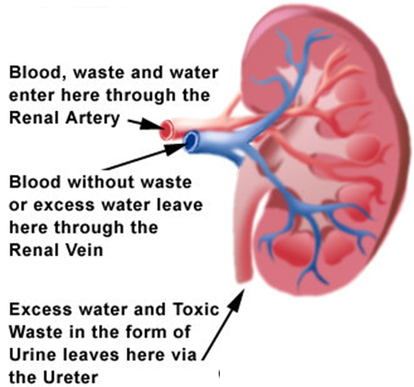
Function of the Kidneys
The functions of the kidneys are:
to regulate the quantity of extracellular fluid in the body; to maintain the body's internal equilibrium of water and minerals ⁽¹⁾. This helps regulate the blood pressure.
to filter the blood: to excrete waste-products of the metabolism. All the blood in our bodies passes through the kidneys several times a day. The kidneys produce urine, via which superfluous water and minerals as well as metabolic waste products are removed from the body.
to play an important role in the production of red blood cells and bone formation.
Can you imagine an industrial filter that could be used in a process for more than 70 years without ever being replaced or cleaned?
⁽¹⁾ sodium, potassium, chloride, calcium, phosphorus, magnesium, sulphate
©
Function of the kidney
dr. Chris R. Mol, BME, NORTEC, 2015

Slide 4
Intermezzo: the Excretory system of the human body
The excretory system is the total system that removes waste products and other unwanted systems from the body. Its components:
the Kidneys excrete superfluous water, minerals, and urea. Excretion takes place via urethra and bladder.
the Liver takes care (breaks down) complex chemicals and poisons. The liver also produces bile, which the body uses to break down fats and unusable waste.
the large Intestines break down food and excrete the rest products
the Skin excretes sweat and removes excess water
the Lungs excrete carbon dioxide as part of respiration
©
Function of the kidney
dr. Chris R. Mol, BME, NORTEC, 2015

Slide 5
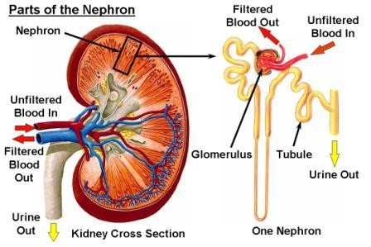
Blood filtration (anatomy)
Each kidney contains around a million units called nephrons, each of which is a microscopic filter for blood. A nephron is a tube-like structure lined by a single layer of specialized cells and surrounded by capillaries. The function of these lining cells are:
the secretion of wastes from the blood into the urine;
the re-absorption of water and small molecules from the filtrate into the blood.
Each nephron begins with a filtration component that filters blood entering the kidney. This filtrate then flows along the length of the nephron. See next slide.
©
Function of the kidney
dr. Chris R. Mol, BME, NORTEC, 2015

Slide 6
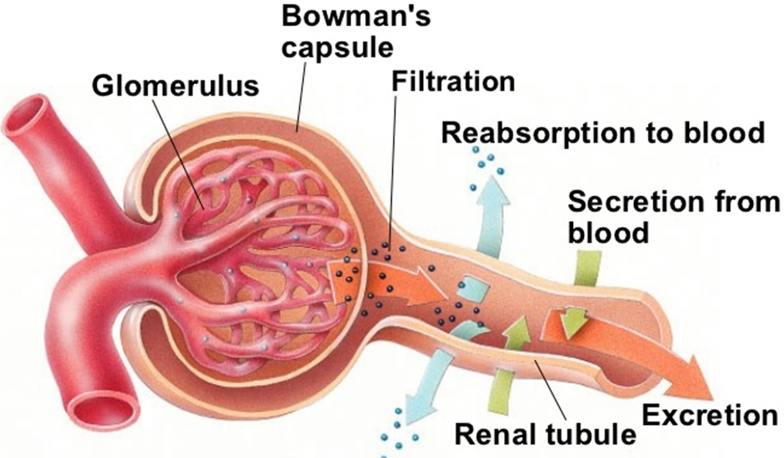
Blood filtration (schematic)
©
Function of the kidney
dr. Chris R. Mol, BME, NORTEC, 2015

Slide 7
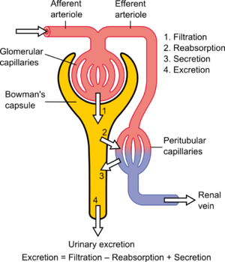
Blood filtration
A global assessment of renal function is often ascertained by estimating the rate of filtration, called the glomerular filtration rate (GFR), which can be calculated from measurements such as urine concentration, urine flow and plasma concentration.
It's possible to lose as much as 90% of kidney function without experiencing any symptoms or problems.
©
Function of the kidney
dr. Chris R. Mol, BME, NORTEC, 2015

Slide 8
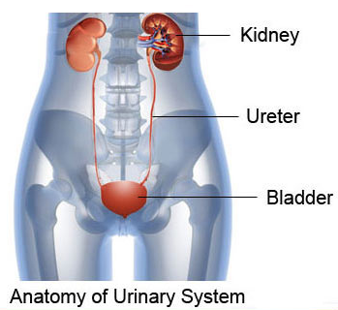
Ureters and bladder
Ureters are tubes made of smooth muscle fibres that propel urine from the kidneys to the urinary bladder.
In the adult, the ureters are usually 25–30 cm long and ~3–4 mm in diameter.
A kidney stone can move from the kidney and become lodged inside the ureter, which can block the flow of urine, as well as cause a sharp cramp in the back, side, or lower abdomen.
The urinary bladder is the organ that collects urine excreted by the kidneys before disposal by urination. A hollow muscular, and elastic organ, the bladder sits on the pelvic floor. Urine enters the bladder via the ureters and exits via the urethra. The volume of the human bladder, is 500 to 1,000 milli-litres.
For the urine to exit the bladder, both the autonomically controlled internal sphincter and the voluntarily controlled external sphincter must be opened. Problems with these muscles can lead to incontinence.
©
Function of the kidney
dr. Chris R. Mol, BME, NORTEC, 2015

Slide 9
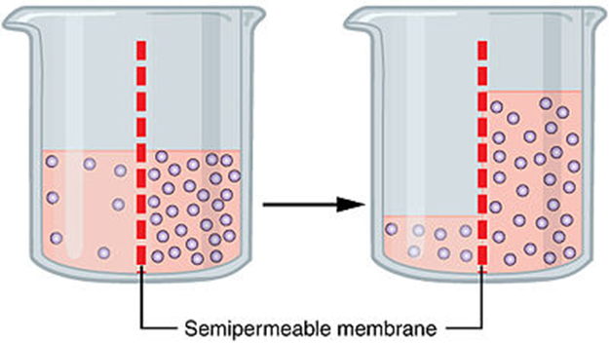
Osmosis
video !
The blood filtration in the kidneys works via osmosis, which is a special case of diffusion. The kidneys use active transport (especially of Na⁺) to set up osmotic gradients.
Osmosis is the spontaneous net movement of water (solute) molecules through a semi-permeable membrane (that do not allow the passing of the solvent, Na⁺) into a region of higher solvent (Na⁺) concentration in the direction that tends to equalize the solute concentrations on the two sides.
Osmosis is a vital process in biological systems, as biological membranes are semi-permeable.
In general, these membranes are impermeable to large and polar molecules, such as ions, proteins, and polysaccharides, while being permeable to non-polar as well as to small molecules like oxygen, carbon dioxide, nitrogen, and nitric oxide.
Osmosis provides the primary means by which water is transported into and out of cells.
see for a simple explanation of diffusion & osmosis: http://www.mun.ca/biology/Osmosis_Diffusion/tutor2.html
©
Function of the kidney
dr. Chris R. Mol, BME, NORTEC, 2015

Slide 10
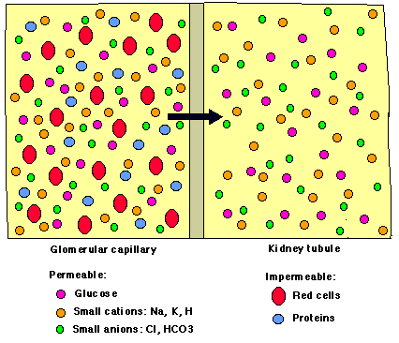
Osmosis
©
Function of the kidney
dr. Chris R. Mol, BME, NORTEC, 2015

Slide 11
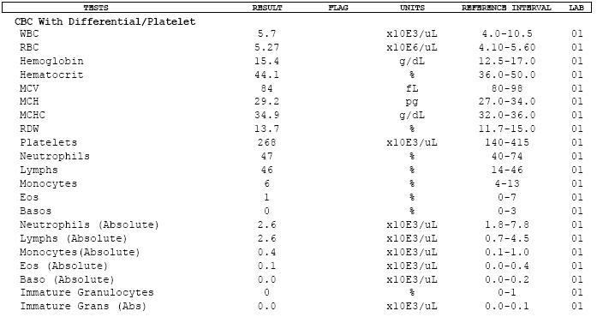
Tools used for diagnosis of renal disease
1. Clinical findings & physical exam
2. Laboratory studies
Blood: a complete blood count (CBC): blood serum electrolytes; blood urea, nitrogen and creatinine; blood glucose and hemoglobin.
Urine analysis is used to evaluate urine for its pH, protein, glucose, specific gravity and the presence of blood. Microscopic analysis can be helpful in the identification of casts, red blood cells, white blood cells and crystals.
Complete blood count results
©
Function of the kidney
dr. Chris R. Mol, BME, NORTEC, 2015

Slide 12
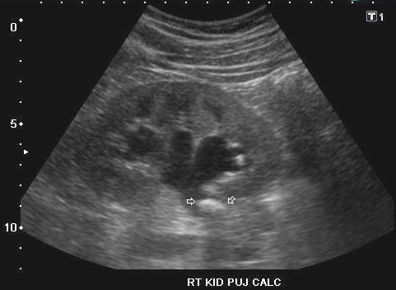
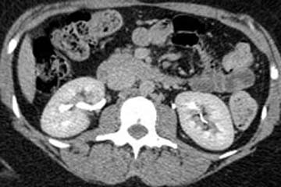
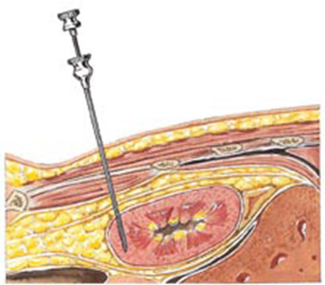
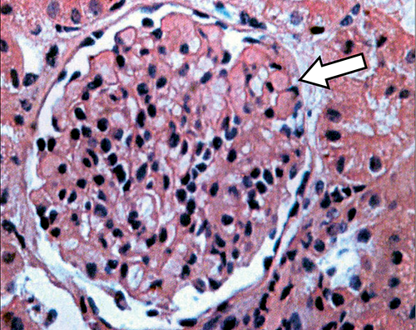
Tools used for diagnosis of renal disease
3. Imaging studies
Renal ultrasound
CT scan.
ultrasound image with kidney stones
CT scan with kidneys
4. Renal biopsy
light microscopy, immunofluorescence microscopy and electron microscopy with multiple staining techniques
biopsy
procedure
microscope image
of biopsy
©
Function of the kidney
dr. Chris R. Mol, BME, NORTEC, 2015

Slide 13
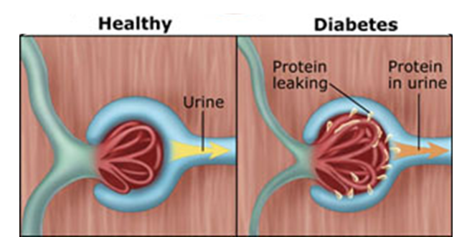
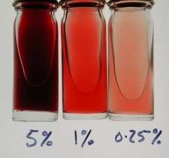
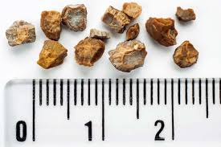
Diseases of the Kidney
Diabetic nephro-pathy is a progressive kidney disease caused by disease of the capillaries in the kidney glomeruli. It is the consequence of diabetes (high blood sugar levels over a prolonged period), and is a prime cause for dialysis in many Western countries.
Haematuria is the presence of blood in the urine. It is a sign of a large number of diseases of the kidneys and the urinary tract, ranging from trivial to lethal.
Kidney stones are solid crystals in urine found inside the kidneys or ureters. They vary in size from as small as a grain of sand to as large as a golf ball. Kidney stones typically leave the body in the urine stream; if they grow relatively large before passing (on the order of millimeters), obstruction of a ureter and distention with urine can cause severe pain most commonly felt in the flank, lower abdomen and groin.
©
Function of the kidney
dr. Chris R. Mol, BME, NORTEC, 2015

Slide 14
Diseases of the Kidney
not part of exam
Pyelonephritis is when an infection of the renal pelvis spreads into the kidney. It usually results from the spread of faecal bacterium from the anal region superiorly through the urinary tract. In severe cases, the kidney swells and scars, abscesses form, and the renal pelvis fills with pus. Left untreated, the infected kidney may be severely damaged, but administration of antibiotics usually achieve a total cure.
Glomerulonephritis is an inflammation of the glomerular. It can be caused by immunologic abnormalities, drugs or toxins, vascular disorders, and systemic diseases. Glomerulonephritis can be acute, chronic or progressive. It shows up by blood and proteins in the urine. There is also a decrease in urine as there is a decrease in the Glomerular Filtration Rate.
Renal Failure. This is characterized by uraemia, which means that there is urine in the blood. It is a syndrome of renal failure. Acute renal failure can be caused by severe hypotension or severe glomerular disease.
©
Function of the kidney
dr. Chris R. Mol, BME, NORTEC, 2015

Slide 15
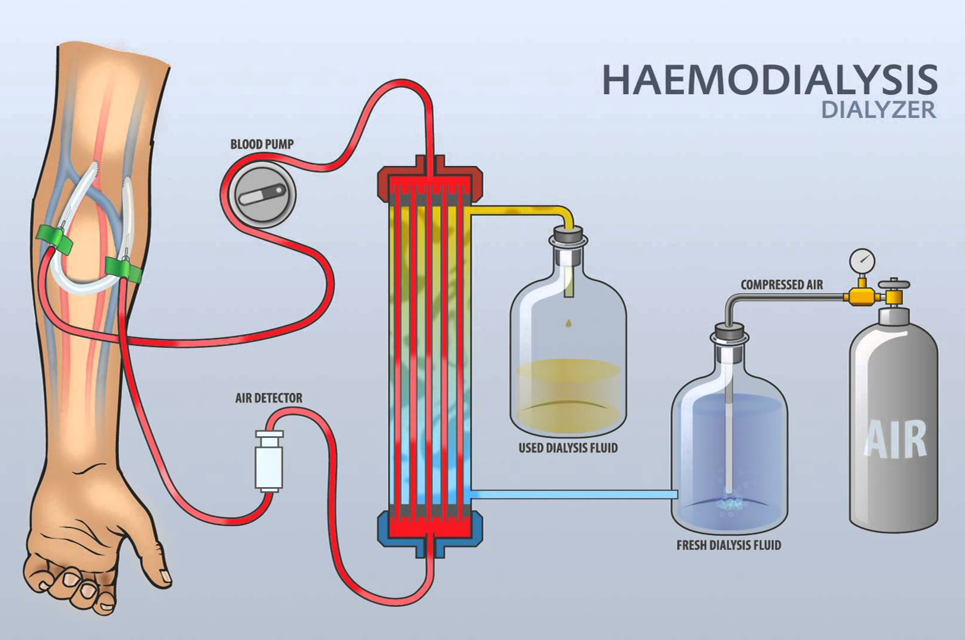
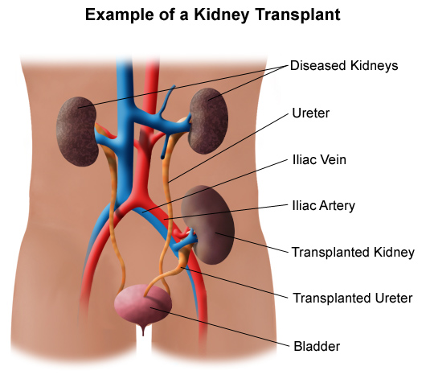
Treatments
Haemodialysis
Generally, humans can live normally with just one kidney. Only when the amount of functioning kidney tissue is greatly diminished will renal failure develop. Provided that treatment is begun early, it may be possible to reverse chronic kidney failure due to diabetes or high blood pressure. In "end-stage renal failure" haemodialysis needs to be performed. This is a supportive treatment; a form of "buying time" to bridge the wait for a suitable organ for kidney transplantation.
Kidney transplantation is the only cure for end-stage renal failure. There are two types of kidney transplants: living donor transplant and a dead donor transplant.
When a kidney from a living donor is transplanted into the patient's body, the donor's blood group and tissue type must be compatible with the patient's.
Before a dead donor's organs can be transplanted, tests must be done to determine if the organs are healthy. Also, in some countries, the family of the donor must give its consent for the organ donation.
In both cases, the recipient of the new organ needs to take drugs to suppress their immune system to help prevent their body from rejecting the new kidney.
©
Function of the kidney
dr. Chris R. Mol, BME, NORTEC, 2015

Slide 16
END
The creation of this presentation was supported by a grant from THET:
see https://www.thet.org/

